Slide 1


VENDOR AND CONTRACT MANAGEMENT SYSTEM
Team Lead: Harsha L Pawar
Team Members: Pavan , Kiran , Akash A , Thippeswamy
Institute: Ballari Institute of technology and Management
Date:28/09/2024

Slide 2
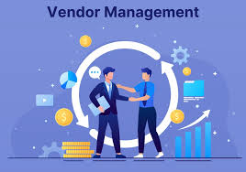
INTRODUCTION
OUR COMPANY
Vendor contract management software is a digital solution that helps your company streamline the vendor approval process.
It can include creating vendor contracts, managing your supplier relationships, and even keeping track of important documentation like invoices and contracts.

Slide 3
Problem Statement:
In today’s business environment, organizations rely heavily on various vendors for products and services. Managing these vendor relationships effectively is crucial for operational success. A comprehensive Vendor Management System is necessary to track vendor performance, manage contracts, and ensure timely actions related to contract expirations.
The primary objective is to develop a robust Vendor Management System that enables users to efficiently manage vendor information, associated contracts, and performance metrics. The system should provide functionalities for adding vendors, tracking contract expiration, updating performance scores, and removing vendors as needed

Slide 4
Objectives of Vendor Contract management:
Minimizing Risk
Improving Financial Outcome.
Building Long-term Relationship.
Ensuring Compliance.
Maintaining a Complete Record.
Tracking Performance.
Prioritizing data Security.
Staying up to Date.

Slide 5



Technology and Tools Used:
Python: This program is written in python , a high-level language known for its readability and simplicity.
Date-Time Module: the code imports Datetime and timedelta from the datetime module.
OOPS(Object-Oriented Programming): The system is designed using oop principles with classes defined for Vendor , Contract, and Vendormanagement.
Data Structure: The system uses dictionaries (self.vendors)
Exception Handling: The code includes basic error handling for user inputs, such as convert string to integer or parsing date and future enchancements.

Slide 6
Benefits of using vendor contract management system
1.Create an organized, cohesive solution where all vendor information is stored
2.Improve and optimize vendor lead times, timelines, and contract schedules
3.Ensure contract and legal compliance
4.Maximize security
5.Guarantee best practices between you and your preferred vendor

Slide 7
Project Plan and Algorithms used:
Algorithms
Project Plan
Object-Oriented Design.
CRUD Operations.
Date Comparison.
Searching Method.
Iteration loops.
Input Handling.
System Design.
Project Overview.
Requirements Gathering.
Plan Implementation.
Testing.
Documentation.
Resource Allocation.
Deployment.

Slide 8
CRUD is the acronym for CREATE, READ, UPDATE and DELETE.
These terms describe the four essential operations for creating and
managing persistent data elements, mainly in relational and NoSQL databases.
CREATE
The CREATE operation adds a new record to a database
READ
READ returns records (or documents or items) from a database table (or collection or bucket) based on some search criteria
UPDATE
UPDATE is used to modify existing records in the database
DELETE
DELETE operations allow the user to remove records from the database

Slide 9
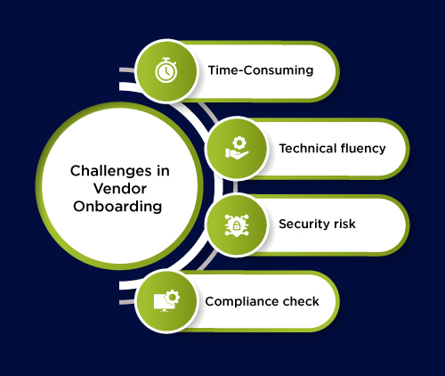
Challenges to vendors
Challenges in Vendor Contract Management
- Common Issues:
- Lack of visibility and tracking.
- Poor communication and stakeholder involvement.
- Compliance and legal risks.

Slide 10
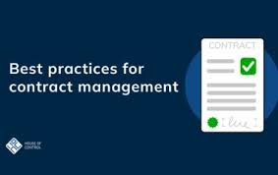
Best Practices
→ Centralized Database: Maintain a comprehensive contract repository.
→Regular Training: Ensure staff is trained on contract management processes.
→Performance Reviews: Regularly assess vendor performance against contract terms.

Slide 11
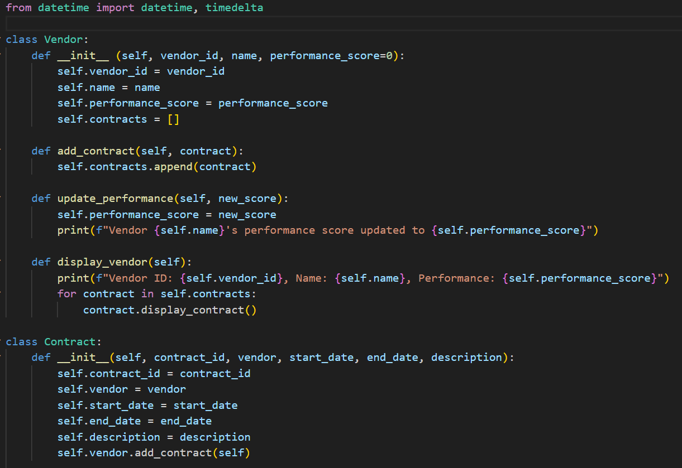
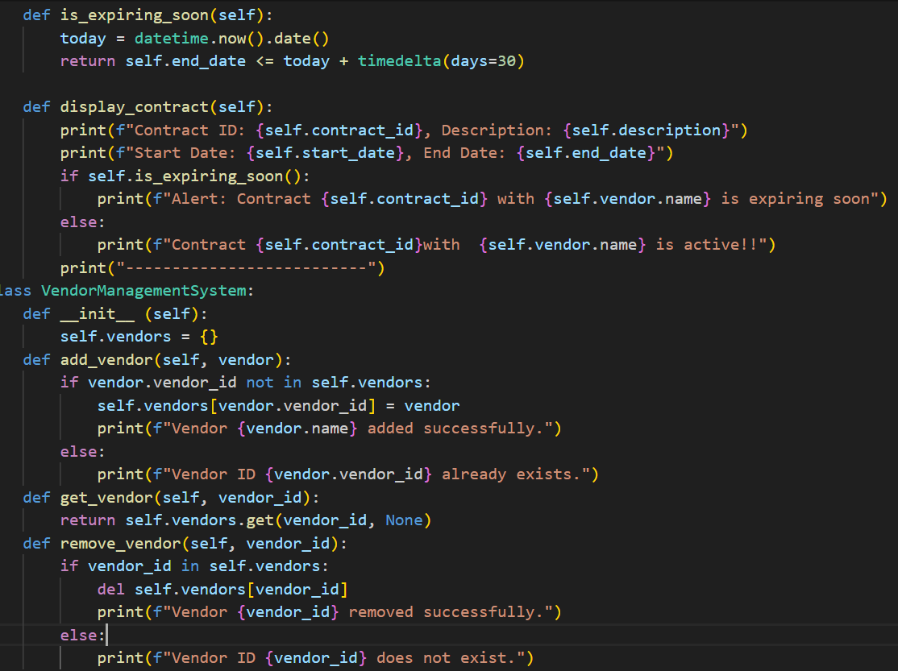

Slide 12
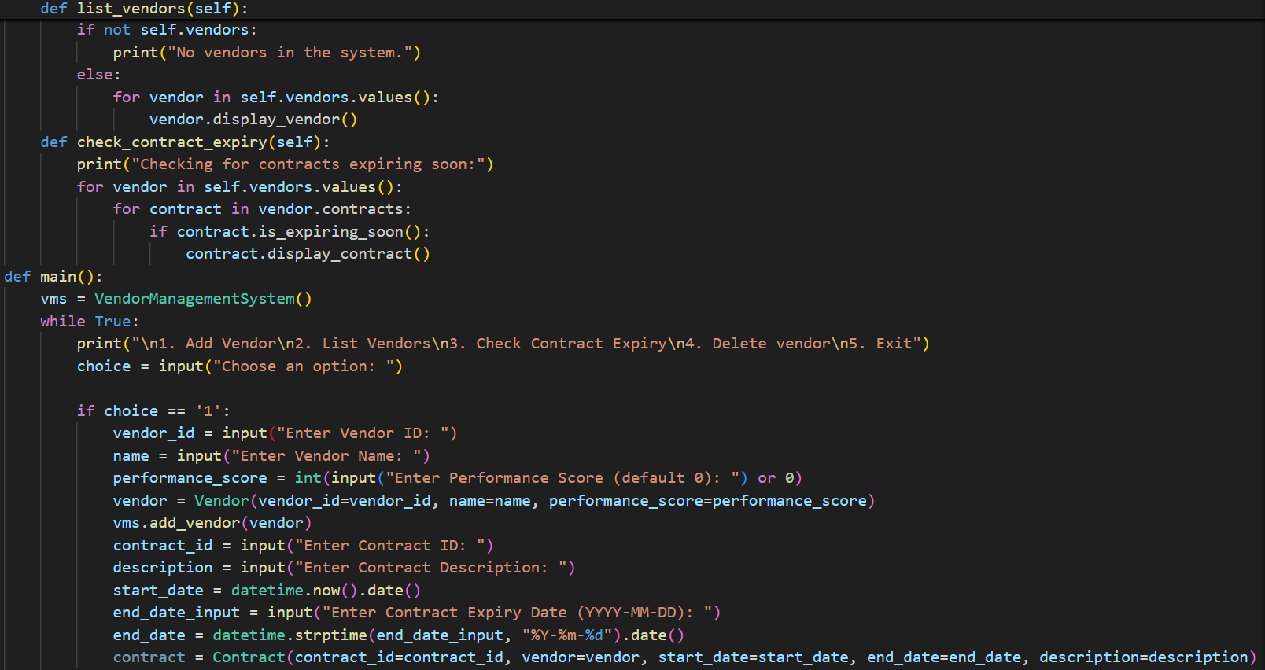
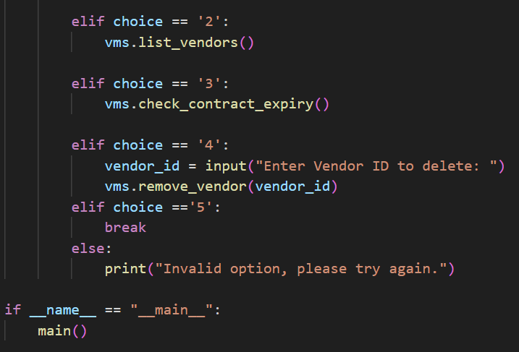

Slide 13
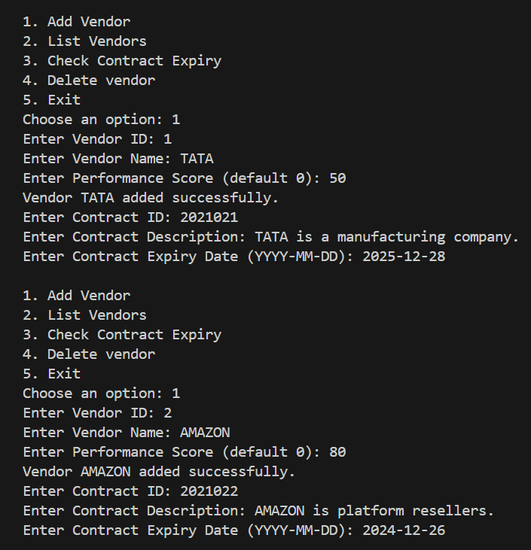
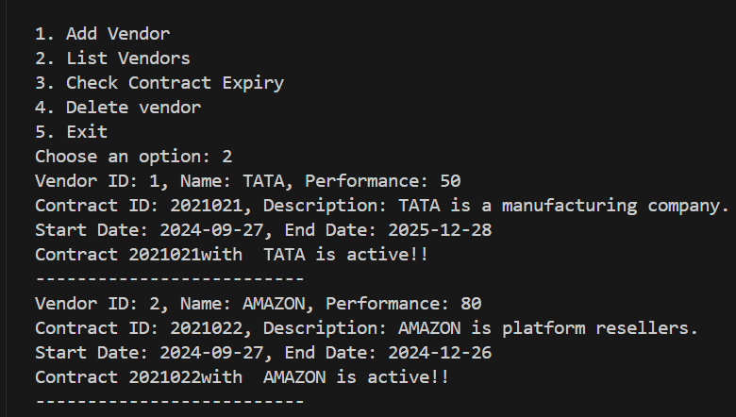

Slide 14
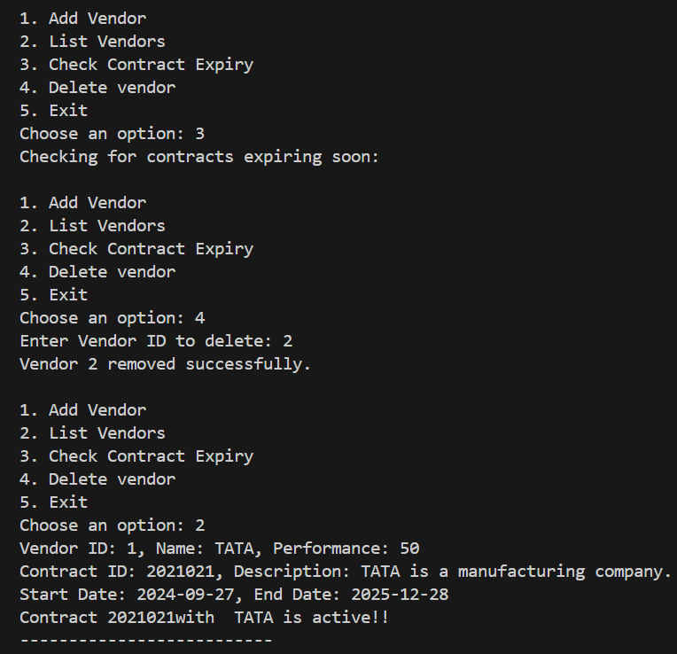
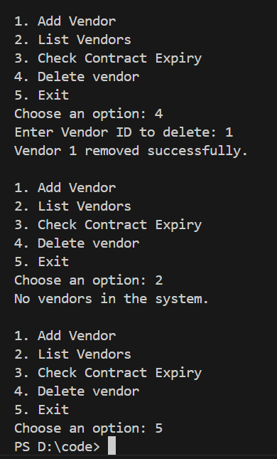

Slide 15


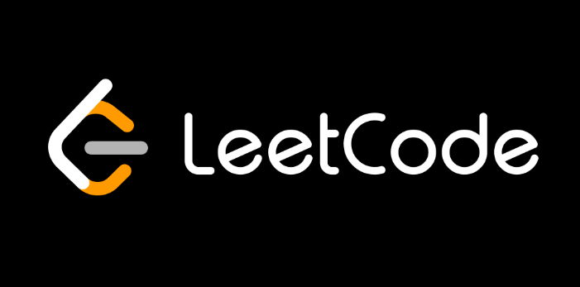

THANKS!
Do you have any questions?
Also Available on:

